Slide 1






Prepared for Barclays
+
Barclays: become a Pioneer Sponsor in Banking
An invitation to sponsor learners and lead banking’s contribution to education.
Kewordal: the Tech for Good, AI-powered social learning education network.
October 2026 | Private & Confidential
Strictly Private & Confidential – Disclaimer

Slide 2




Barclays and Kewordal at a glance
For Barclays Kewordal is business’s answer to supporting education.
The offer
Your brand
Your place
Next step
Sponsor learners on Kewordal, the Tech for Good, AI-powered social learning education network.
Barclays’ logo on every learner you sponsor, from launch, linking to your own page on Kewordal.
One of only three Pioneer Sponsor places in banking, from £25,000, while places remain.
Packages from £2,995. Play the challenge on the next page, then let’s talk.
Kewordal | Private & Confidential | Prepared for Barclays
2

Slide 3
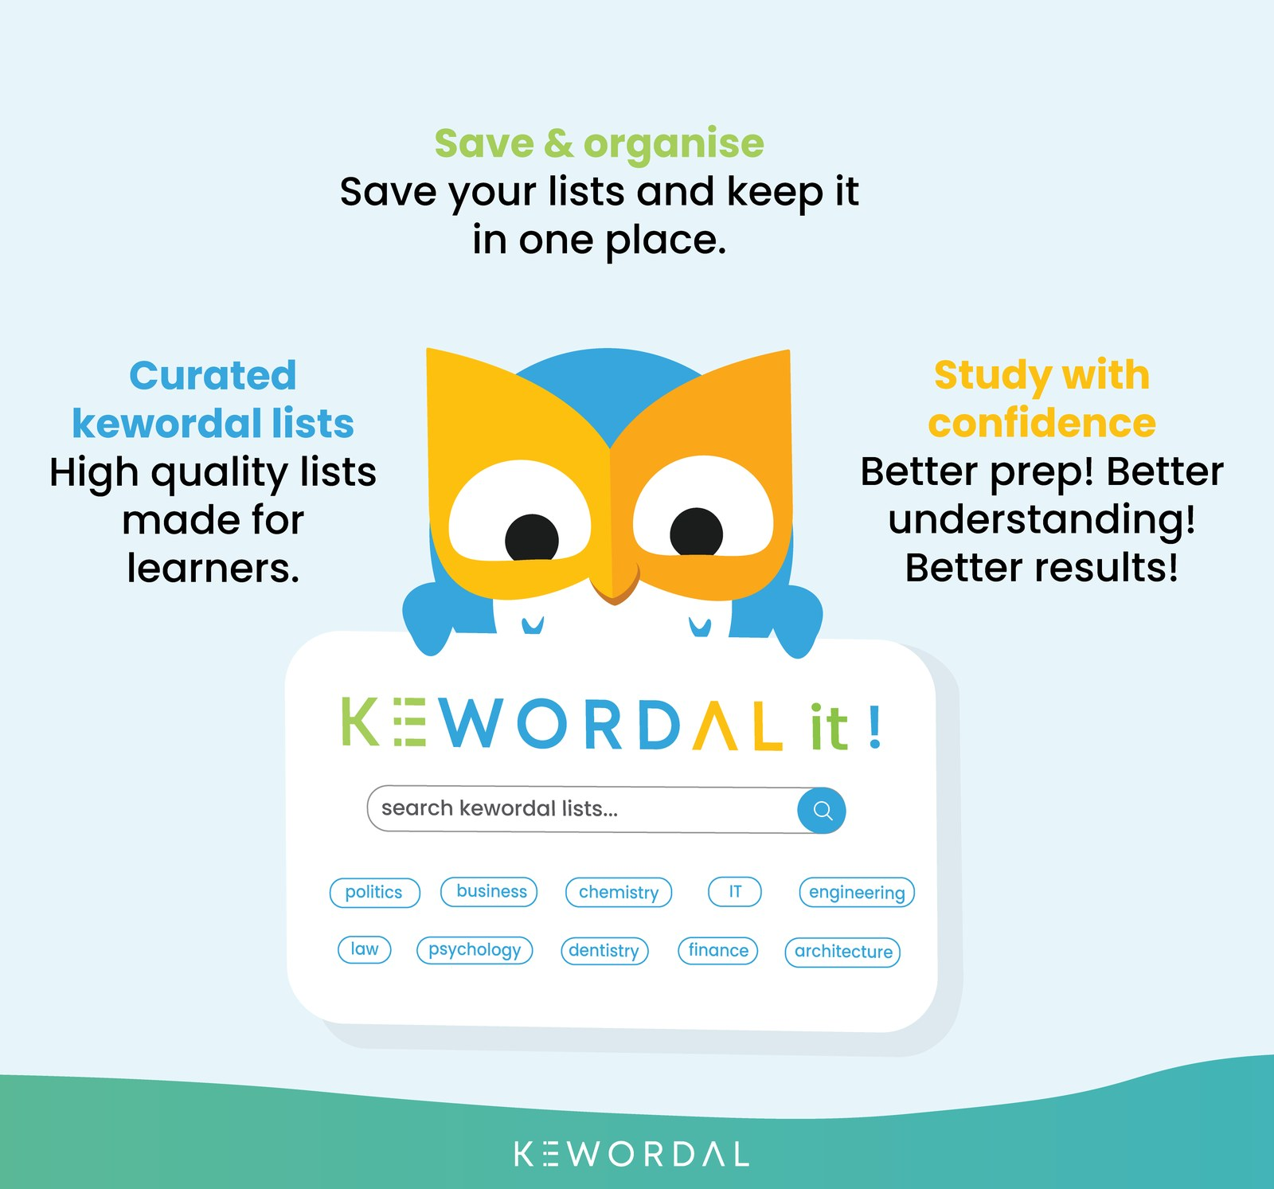
Your challenge
We built a Kewordal list about your career. Michael played it first.
Drawn from public sources, with some of Barclays' story too. Can you beat his score on the one subject you should know best? It takes two minutes.
Score to beat
Michael Watson
[X]/10
Play the challenge: [challenge link]
Win or lose, you will have experienced Kewordal before we ever meet.
Kewordal | Private & Confidential | Prepared for Barclays
3

Slide 4





Barclays at the centre
Kewordal is the vehicle for businesses to engage in education and social impact, globally.
At launch, Barclays sponsors learners and your logo appears on every one of their profiles. As Kewordal grows, that reach multiplies.
Pioneer Sponsor, Banking
Stage 1 · one of three places
Sponsored learners
Stage 1 · Barclays' logo on every profile
Barclays mentors
Stage 3
A. Building Kewordal lists
B. Conversational
C. Full engagement
Stage 1 At launch
amplified by
Stage 2 As we grow
Stage 3 Later, on our roadmap
Social education influencers
Stage 2 · amplifying your logo
How learners will grow
Social education influencers · school and university pilots · our mobile app · Partnership Leads · sponsors’ own campaigns
Schools and universities
Stage 3 · sponsoring student subscriptions, with work experience links later
Peer banks
Stage 2 · via the Pioneers’ Circle
Kewordal | Private & Confidential | Prepared for Barclays
4

Slide 5


Three learners, one network
For Barclays José and Josh are who Barclays sponsors. Samantha could be a Barclays colleague.
Josh
Samantha
José
Personalisation. Collaboration. AI.
Beyond the curriculum
Global impact
Builds his own keyword lists from what he is learning
Learns from friends and challenges them on the leaderboard
Asks KAIL, Kewordal's AI learning assistant, to explain whatever he is stuck on
Engages with mentors and teachers as part of a social learning community
Uses Kewordal for her own personal self-development
A City of London lawyer building lists in her own field to help learners
Adds expert knowledge far beyond any syllabus to accelerate the learner's attainment
Can become a mentor and coach, if she chooses
A learner in a Brazilian favela with less access to education resources
Connected to Samantha through a shared list that helps him learn English
Sponsored by Samantha to use Kewordal - also helping his family, who cannot afford to, and inspiring the friends connected to him
Helping 10 million Josés. Connecting 1 million Samanthas.
Kewordal | Private & Confidential | Prepared for Barclays
5

Slide 6
What learners need
For Barclays Barclays' people are the positive role models learners are missing: their knowledge, shared safely and at scale.
Fragmented by design
No wider support
Missing mentors
LMS is not social; social networks are not built for learning; general AI is not safeguarded for minors.
Learners lack social tools to reach wider support, and experts have no scalable way to share knowledge.
Millions of learners have little or no access to mentors as positive role models and education influencers.
The need One place that brings learning, positive role models and safe AI together for millions of learners.
Kewordal | Private & Confidential | Prepared for Barclays
6

Slide 7



Kewordal, with KAIL built in
For Barclays Safeguarding-first by design: safe for the learners Barclays sponsors, and for Barclays' brand.
What is Kewordal?
What KAIL does
Built-in safeguards
A social education and learning network: educating people, and learning from people
Build it: turn any topic into a keyword list in seconds
Play it: every keyword becomes a question in games, quizzes and challenges
Connect with it: follow, challenge friends and climb leaderboards
200 subjects, from law to engineering
Explains any keyword in clear, age-appropriate language
Summarises a list thematically
Suggests additional relevant keywords
Shows how two keywords relate
Gives real-world context for why a keyword matters
Scoped to the learner’s list, not open-ended chat
Vocabulary adapts to the account’s age band
Permanent accuracy notice linking to a public support page
Thumbs up/down gives young users a safe way to flag a bad answer
No permanent storage of conversations
No AI training on user data without explicit opt-in
Watch a short demo of Kewordal
Every learner Barclays sponsors gets the same safeguarded, age-adaptive experience.
Kewordal | Private & Confidential | Prepared for Barclays
7

Slide 8

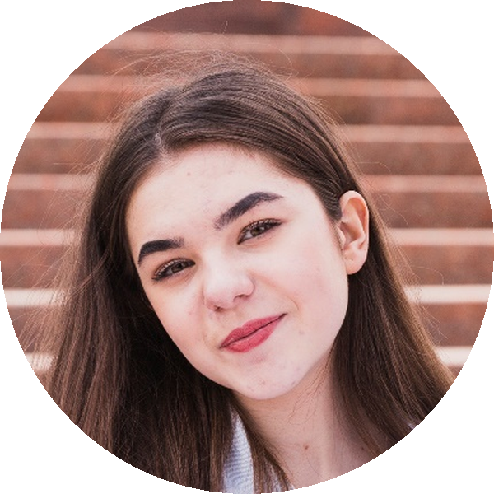


What Barclays' sponsorship looks like
For Barclays At launch, your brand on every learner you sponsor. Your profile page follows.
kewordal.com/sponsors/barclays
⋮
Coming after launch
Barclays
1,200
learners sponsored
Hannah
Pioneer Sponsor No. 1 · Banking
Learner
Economics
From our CEO
Our commitment to social education and learning
Our social impact
Connect
Your CEO’s message, in their own words: why Barclays backs learners, and what it means for your people.
Through Kewordal, we sponsor 1,200 learners in economics, finance and business, and our colleagues share their expertise by building Kewordal lists.
We help people build the skills and confidence to manage money, find work and start businesses.
Sponsored by
Written by your CEO
Example text
Example text
Live at launch
Illustrative mock-up
Kewordal | Private & Confidential | Prepared for Barclays
8

Slide 9
What Barclays gains
For Barclays Be among the first to back learners, with Barclays' brand amplified by our social education influencers.
Influence
Reputation
Opportunities
Networks
Seen as a progressive business invested in global education and social impact, by learners, institutions and the banking sector.
Your brand linked to better educational and social outcomes, shown publicly on your profile page.
Your workforce shares its expertise by building Kewordal lists, and later through mentoring and work experience: a pathway from learning to work.
Learners, educators and sector peers follow Barclays on Kewordal, building a lasting audience for your brand.
Kewordal | Private & Confidential | Prepared for Barclays
9

Slide 10


Pioneer Sponsors, Banking: three places
Three per sector
What you receive
Numbered by sector
A permanent title
As Pioneer Sponsor
First come, first numbered
The first three organisations in banking to sponsor at Super Partnership level, from £25,000
Major Sponsors, from £50,000, feature on a dedicated Major Sponsors page, with clickable links to their profile page
Each keeps its number permanently: Pioneer Sponsor No. 1, 2 or 3, Banking
1. First access to your sponsor profile page
2. Top placement for banking on the public sponsor dashboard
3. An invitation to the Pioneers’ Circle, taking turns to lead your sector
Every sponsor is numbered in order of joining, sector by sector
Barclays could be Banking No. 1; the next two to join, No. 2 and No. 3
Your number appears on your profile page and the sector dashboard
3 per sector
No. 1–3
£50k+
three in banking; 99 in 33 sectors and growing
numbered permanently, in order of joining
Major Sponsors, featured on a dedicated page
Kewordal | Private & Confidential | Prepared for Barclays
10

Slide 11







The Pioneers’ Circle
Shape how banking engages with social education and learning, globally, and bring your peers with you.
By invitation
For pioneering sponsors, starting with each sector’s three Pioneer Sponsors, who take turns to lead their sector. Our partner-level relationship.
Shape your sector’s engagement
Members help to shape how Kewordal rolls out in banking, as company coordinators did in the mentoring scheme Michael ran (page 12). Michael's background
Reach your peers
Members lead outreach to peer banks. Kewordal celebrates the sector as a whole, “Banking, led by its Pioneer Sponsors”, so the pioneers and the whole sector share the credit, and sectors can see how they compare.
The forerunner of the Patrons’ Circle
An inclusive body for business. Every member, large or small, has a voice in how their sector shapes education and social impact, globally.
When the planned Kewordal-linked charity is established, Pioneers' Circle members will be among those invited to become founding members of its Patrons' Circle.
Kewordal | Private & Confidential | Prepared for Barclays
11

Slide 12
What Barclays could fund
For Barclays With every package, Barclays' brand appears on each sponsored learner’s profile.
Standard learners sponsored for one year, per package
£2,995
£3,995
£4,995
£10,000
24 learners
36 learners
48 learners
125 learners
Super Partnership for large-scale, early sponsorship, per year
Pioneer Sponsor places start here
Major Sponsor
Major Sponsor
£25,000
£50,000
£100,000
300 learners
600 learners
1,200 learners
Kewordal | Private & Confidential | Prepared for Barclays
12

Slide 13
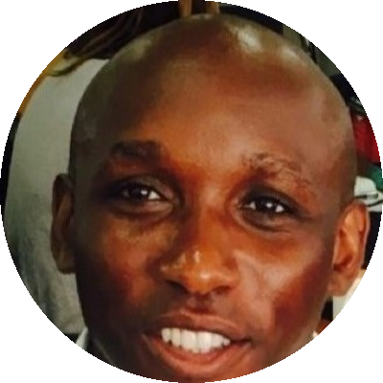

Built on proven experience
For Barclays Kewordal’s two foundations were proven in practice long before the platform was built.
Social good isn’t a feature we added. It’s the reason Kewordal exists.
1
Proven: keyword learning works
2
Proven: companies want to engage
Led by that experience
Modelling a future of corporate engagement
Where Kewordal lists began
Corporate social responsibility shows how much companies want to contribute to education.
Michael previously ran one of the country’s largest mentoring schemes, in Tower Hamlets: professionals from more than 60 organisations, including the Bank of England, Goldman Sachs, Deloitte & Touche and Unilever, mentoring students from less privileged backgrounds.
Michael Watson
Founder & CEO, Kewordal
His former roles include education recruitment director; external adviser to the Social Exclusion Unit, Cabinet Office; PwC (education consultant); leading two mentoring programmes; and vice chair of governors at a primary and a secondary school. He holds a PhD in Education.
Michael’s background
Flashcards, spider diagrams and similar tools are long-established ways to learn. Keyword lists came from Michael’s own experience.
He first used them as a student, having left school with below-average qualifications. They helped him simplify information, remember it, and close the perceived attainment gap on students he felt were brighter. Kewordal is built on that method.
15
40
1,000
300
schools
coordinators
students
mentors
See all the organisations whose professionals took part
Kewordal now makes this possible for businesses globally, with the first sponsors in each sector leading the way.
Kewordal | Private & Confidential | Prepared for Barclays
13

Slide 14
Built by people who believe in it
For Barclays The commitment that built Kewordal goes into every learner Barclays sponsors.
A Tech for Good team, from the very start.
Our story
Kewordal’s core team began as volunteers.
Since September 2025 they have built the platform together, each giving on average 12 months of their time, often alongside studies and jobs.
Engineering, design, product, content and marketing: a team that chose to build something for good.
“[Quote to come: why I joined Kewordal]”
[First name], [role] · [months] months
“[Quote to come: why I joined Kewordal]”
[First name], [role] · [months] months
“[Quote to come: why I joined Kewordal]”
[First name], [role] · [months] months
“[Quote to come: why I joined Kewordal]”
[First name], [role] · [months] months
If a team will give a year of their lives to build Kewordal, imagine what millions of learners and mentors will do with it.
Kewordal | Private & Confidential | Prepared for Barclays
14

Slide 15
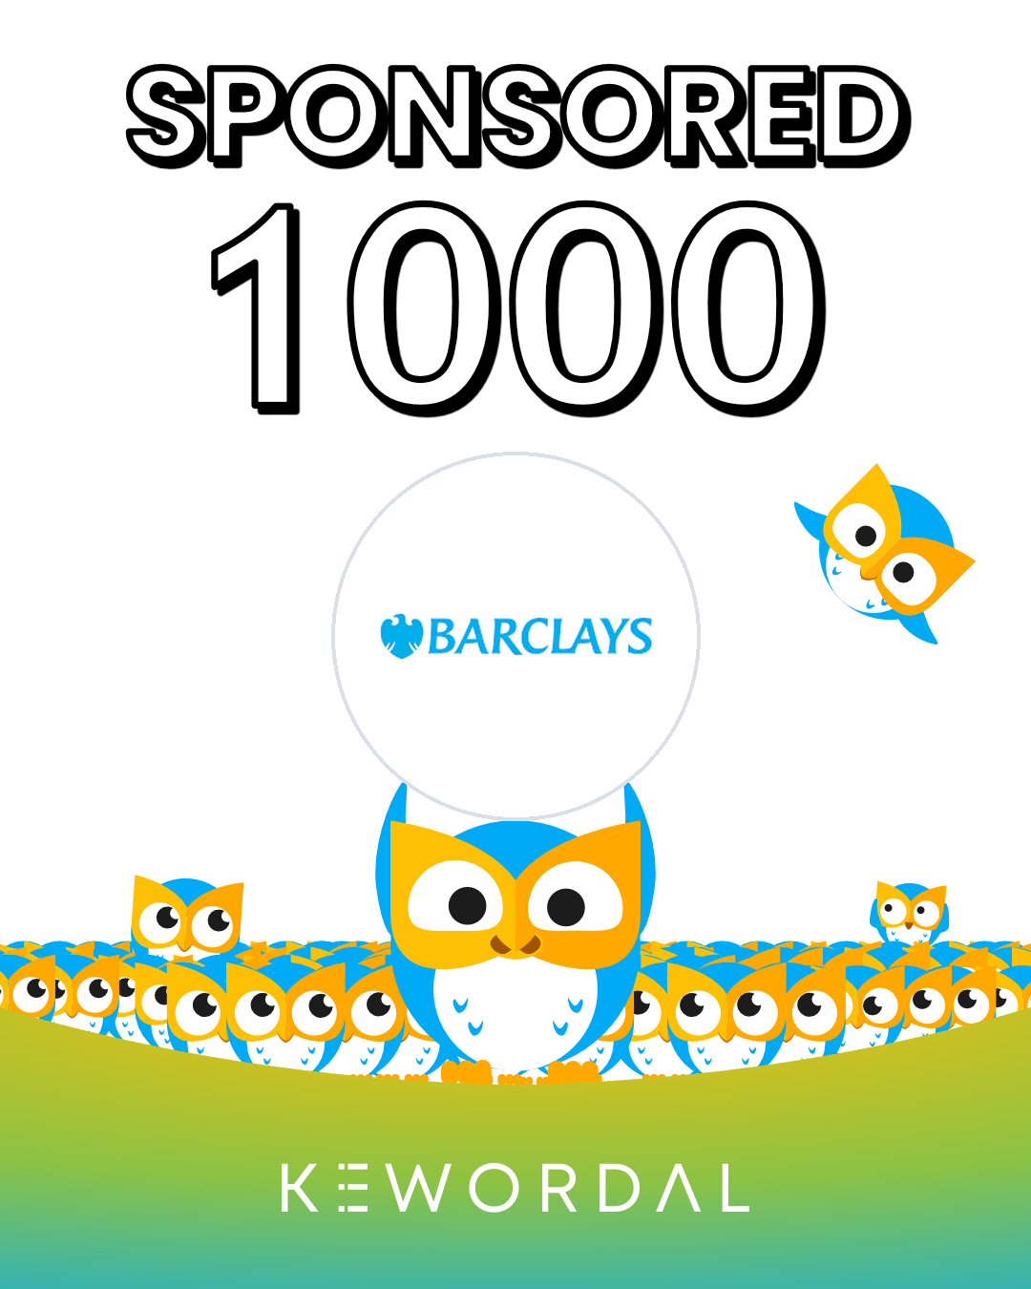
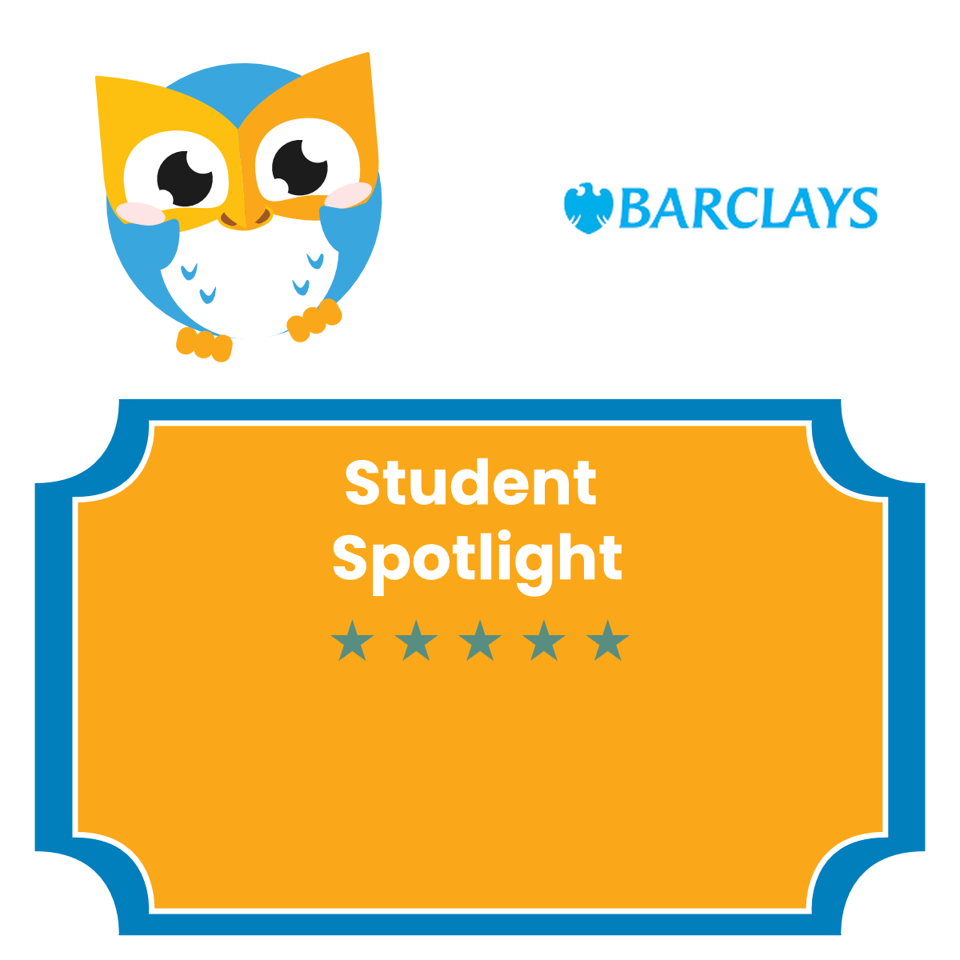
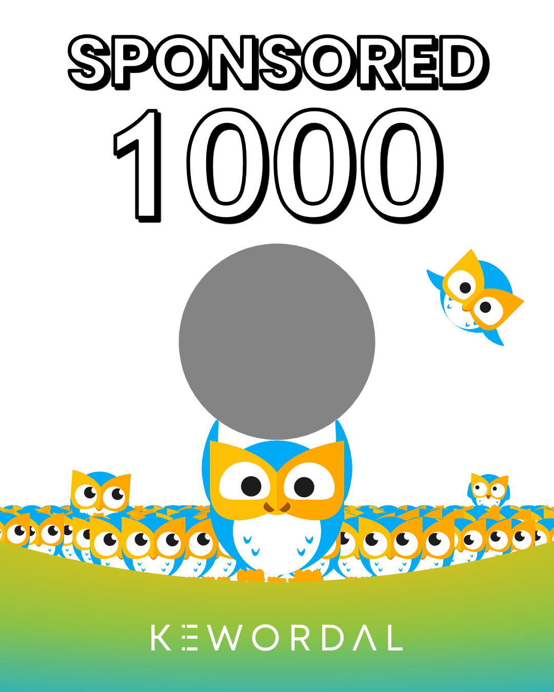
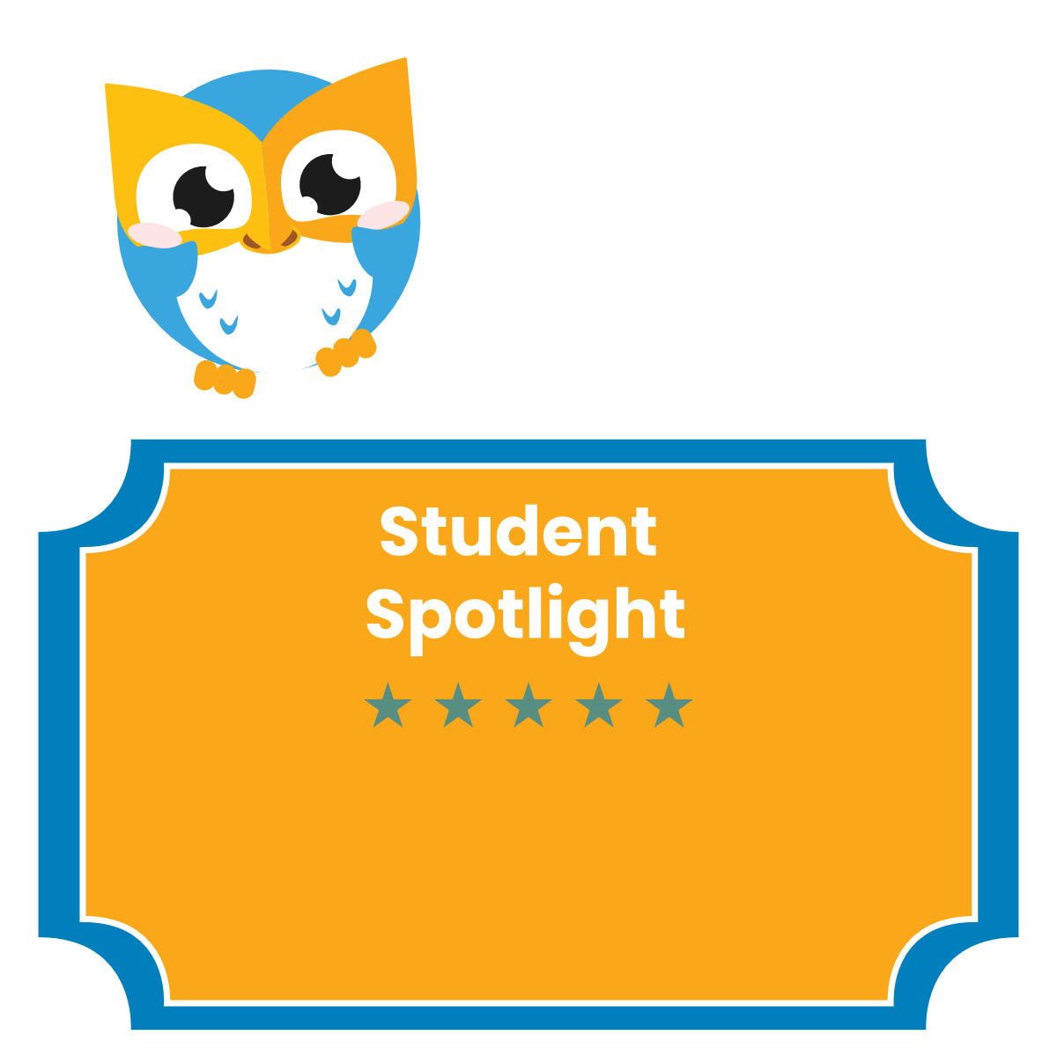
How we celebrate Barclays
For Barclays Every post puts Barclays in front of learners, parents, educators, businesses and policymakers.
The learners Barclays sponsors, celebrated in your brand colours on LinkedIn and other social media platforms.
Sponsored 1000
When Barclays reaches 1,000 sponsored learners, we celebrate it across Kewordal and social media platforms.
Illustrative designs by the Kewordal creative team
Kewordal | Private & Confidential | Prepared for Barclays
15

Slide 16


What’s coming for Barclays
For Barclays Pioneer Sponsors are the first we talk to as each new opportunity arrives.
At launch
Next
Later
Live from day one
Recognition and reach
Deeper connections
Barclays' brand on every sponsored learner’s profile
A Pioneer Sponsor place in banking, and the Pioneers’ Circle
Spotlights on our social media, blog and newsletters, with a “Sponsored 1000” feature at 1,000 learners
Your profile page: CEO message, commitment to education and social impact
Competitions and awards in Barclays' name
Blog, podcast and interview features with Barclays colleagues as positive role models
Conversational mentoring, then full engagement, for Barclays colleagues
Work experience opportunities for learners
Kewordal for your own workforce, licensed in Barclays' name
→
→
Next and Later items are on our roadmap, not yet live.
Kewordal | Private & Confidential | Prepared for Barclays
16

Slide 17

Next steps for Barclays
1
Choose your package
From £2,995 for 24 learners to £100,000 for 1,200. Pioneer Sponsor places start at £25,000.
2
Secure a Pioneer Sponsor place in Banking
Three places in banking, each numbered and held permanently once confirmed.
3
Go live
Barclays' brand appears on every learner you sponsor, with your profile page to follow.
4
Lead your sector
Join the Pioneers’ Circle and bring peer banks with you.
All you have to do is say yes: michael.watson@kewordal.com
Kewordal | Private & Confidential | Prepared for Barclays
17

Slide 18
“Education is the most powerful weapon which you can use to change the world.”
“Try to be a rainbow in someone’s cloud.”
“Alone we can do so little; together we can do so much.”
“Imagination is more important than knowledge.”
— Nelson Mandela, 2003
— Maya Angelou
— Helen Keller
— Albert Einstein, 1929
Our ambition: 10 million learners. 1 million mentors. A social learning education network built on and for positive role models to make the world a better place.
Join us, be our partners and pioneer with Kewordal.
Watch our short video
We would be delighted to follow up about Barclays becoming a sponsor, and securing a Pioneer Sponsor place in banking while places remain.
Michael Watson, Founder & CEO | PhD (Education), MSc, BSc, Dip HRM
michael.watson@kewordal.com | kewordal.com | +44 7742 274680 | linkedin.com/in/drmichaelwatson
Kewordal | Private & Confidential | Prepared for Barclays
18

